Slide 1
Sampling
MKTG 302-01
Spring Semester, 2025
Scott Beck

Slide 2
Student Learning Objectives
Learn about different forms of sampling
Understand sampling design

Slide 3
A consideration and some advice …
Today’s material is a little heavy (but important)!
It will be covered heavily on your upcoming quiz.
Be sure to read Chapter 14 in your book, if you haven’t already.

Slide 4
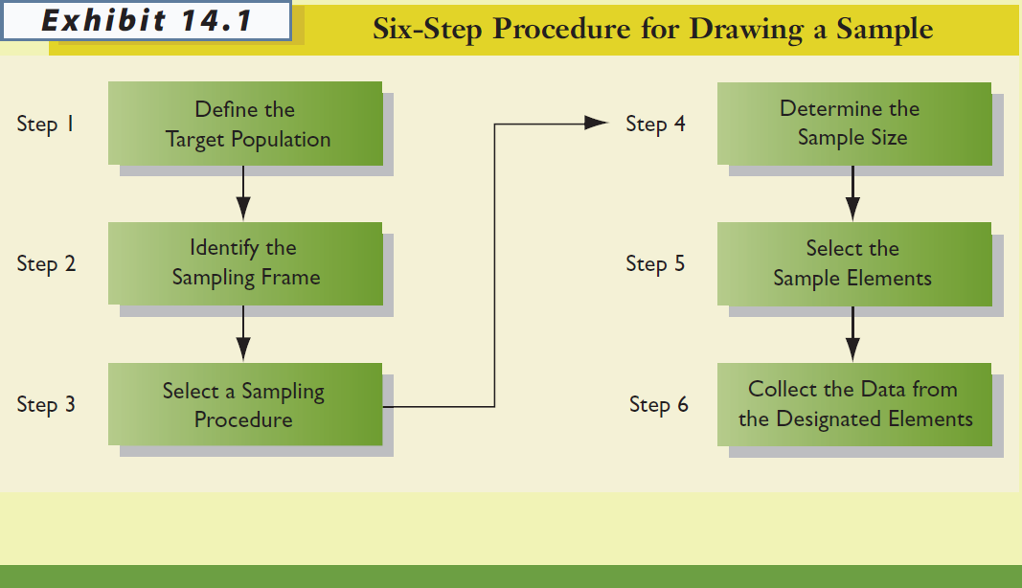

Slide 5
STEP 1: Define the Target Population
POPULATION*
All cases that meet designated specifications for membership in the group.
Researchers must be very clear and precise in defining the population.
Households in the city limits of Cincinnati, OH, with one or more children under the age of 18 living at home.

Slide 6
CENSUS*
A type of sampling plan in which data are collected from or about each member of a population.
SAMPLE*
Selection of a subset of elements from a larger group of objects.

Slide 7
PARAMETER*
A characteristic or measure of a population. Could include measurements such as age, income, etc.
STATISTIC*
A characteristic or measure of a sample.
We calculate statistics from sample data in order to estimate population parameters

Slide 8
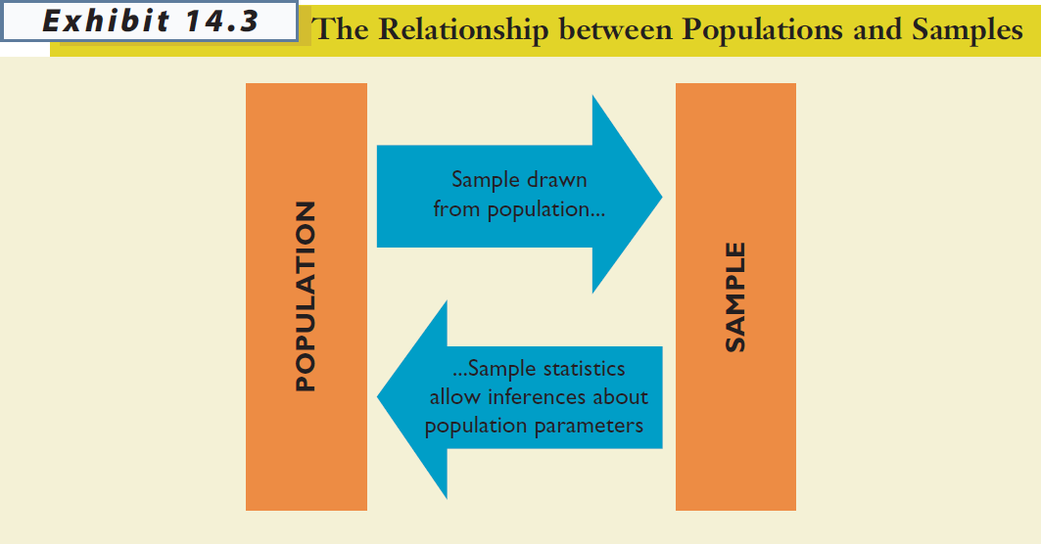

Slide 9
Sampling Error*
The difference between results obtained from a sample and results that would have been obtained had information been gathered from or about every member of the population.
Decreased by increasing sample size
Can be estimated (assuming probability sample)
Usually less troublesome than other kinds of error

Slide 10
STEP 2: Identify the Sampling Frame
SAMPLING FRAME*
The list of population elements from which a sample will be drawn; the list could consist of geographic areas, institutions, individuals, or other units.
Commonly used sampling frames
Customer database, member directories
Lists developed by data compilers

Slide 11
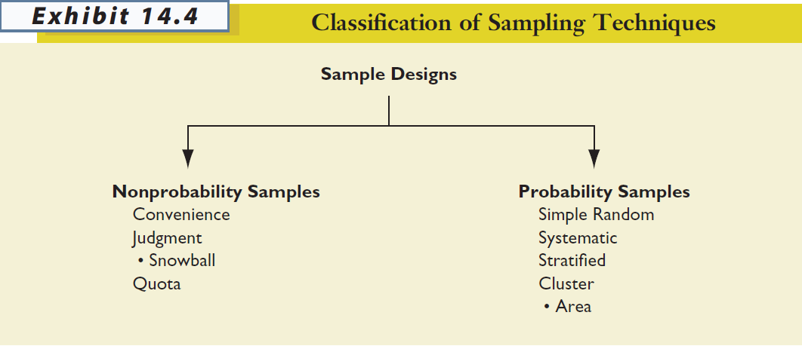
STEP 3: Select a Sampling Procedure
What kind of sample are you going to be using for your projects in this class?

Slide 12
Nonprobability Sample*
A sample that relies on personal judgment in the element selection process.
With nonprobability samples, sampling error cannot be estimated and we cannot calculate the margin of sampling error.
Convenience
Judgment (e.g., snowball)
Quota

Slide 13
Convenience Sample*
A nonprobability sample in which population elements are included in the sample because they were readily available.
Sometimes referred to as “accidental” sampling; population elements are sampled simply because they are in the right place at the right time.
easy to conduct, but no way to know if sample is representative of the population (i.e., cannot statistically assess sampling error).

Slide 14
Judgment Sample *
A nonprobability sample in which the sample elements are handpicked because they are expected to serve the research purpose.
the researcher may believe that the sample elements are representative of the larger population or that they can offer the information needed

Slide 15
Quota Sample *
A nonprobability sample chosen so that the proportion of sample elements with certain characteristics is about the same as the proportion of the elements with the characteristics in the target population.
a “quota” representing these characteristics is established (e.g., 25 males between the ages of 20 and 29; 25 females between the ages of 20 and 29; 35 males between the ages of 30 and 39; etc.) so that when the sample is complete it will mirror the population on the key characteristics

Slide 16

Quota Sampling Example
Research Problem: Investigate undergraduate student attitudes toward controversial technology fee.
Known population parameters: class (30% FR, 20% SO, 30% JR, 20% SR) and gender (50% male, 50% female)
10 students will interview 10 friends each
What should be the composition (class and gender) of those 100 students?

Slide 17
Quota Sampling Example
15 FR men
15 FR women
10 SO men
10 SO women
15 JR men
15 JR women
10 SR men
10 SR women
Student interviewers assigned a “quota” for which types of respondents they need. When all respondents from all interviewers combined, the numbers will match those shown on the left.

Slide 18

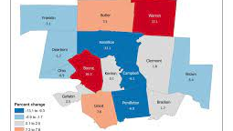
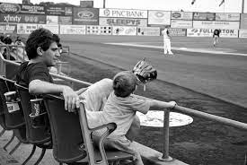

Quick Review …
A review of the terms relevant to Sampling:
Population
Aggregation of individuals and groups you wish to study (i.e., Total US, etc.)
Target Population
Group you are seeking to understand (Census).
Sampling Frame
Group you have access to.
Sample
Who is in your study?
Source: Borrowed from University of Washington

Slide 19
Probability Sample—Must Have Sampling Frame (List) *
A sample in which each target population element has a known, nonzero chance of being included in the sample.
With probability samples there is a random component to which elements are selected; sampling error can be estimated.
Simple Random
Systematic
Stratified
Cluster (including area)

Slide 20
Non Probability Sample—Must Have Sampling Frame (List)
A sample in which there is no way of
estimating the probability that each
participant has of being included in the
sample. Therefore bias is usually introduced.
Convenience
Quota
Judgement
Snowball

Slide 21
Why Use Probability Sampling? *
…because the analyst can statistically assess the level of sampling error and make projections to the population.
(just don’t forget that sampling error is only one kind of error… and it usually isn’t the biggest problem)

Slide 22
Simple Random Sample *
A probability sampling plan in which each unit included in the population has a known and equal chance of being selected for the sample.
if a digital version of the sampling frame is available, implementing a simple random sample is relatively easy

Slide 23
Systematic Sample *
A probability sampling plan in which every kth element in the population is selected from the sample pool after a random start.
if a digital version of the sampling frame is NOT available, but a list of population members exists, this is a useful approach

Slide 24
SAMPLING INTERVAL (k) *
The number of population elements to count (k) when selecting the sample members in a systematic sample.
# elements in sampling frame
k =
total sampling elements

Slide 25
Systematic Sample Example
Knowing that you need a sample pool of 4,762 students to ultimately get about 200 students in your sample, you are in position to draw a systematic sample from the student directory at your university. Further, 42,000 students are listed in the directory.
What is the sampling interval?

Slide 26
SYSTEMATIC SAMPLE EXAMPLE *
Knowing that you need a sample pool of 4,762 students to ultimately get about 200 students in your sample, you are in position to draw a systematic sample from the student directory at your university. Further, 42,000 students are listed in the directory.
What is the sampling interval?
# elements in sampling frame
42,000
k =
=
=
8.8
total sampling elements
4,762
Randomly select one of the first 9 students and then select every 9th student after to be in the initial sampling pool.

Slide 27
Stratified Sample *
A probability sample in which (1) the population is divided into mutually exclusive and exhaustive subsets, and (2) a probabilistic sample of elements is chosen independently from each subset.
most appropriate when strata are homogeneous within but heterogeneous between with respect to key variable(s)
decreased variance within strata on key variable(s) means increased precision
ability to ensure that important strata are represented

Slide 28
Homogeneous and Heterogeneous *
What are the differences?
Homogeneous suggests little variance in the sample
Heterogeneous suggests substantial and expected variance in the sample

Slide 29
Cluster Sample *
A probability sample in which (1) the parent population is divided into mutually exclusive and exhaustive subsets, and (2) a random sample of one or more subsets (clusters) is selected.
strata should be heterogeneous within, homogeneous between
an AREA SAMPLE is a form of cluster sampling in which areas (e.g., census tracts, blocks) serve as the primary sampling units

Slide 30
STEP 4: Determine the Sample Size
To determine the necessary sample size, we need three pieces of information:
how homogeneous (similar) the population is on the characteristic to be estimated
how much precision is needed in the estimate
how confident we need to be that the true value falls within the precision range established

Slide 31
PRECISION *
The degree of error in an estimate of a population parameter. e.g. ± 2
CONFIDENCE *
The degree to which one can feel confident that an estimate approximates the true value. Most often use 95%
Precision and confidence are inversely related; as one increases, the other decreases, all else equal.

Slide 32
Determining Sample Size When Estimating Means *
Where n = required sample size, z = z-score corresponding to the desired degree of confidence, H = half-precision (or how far off the estimate can be in either direction), and σ² = variance of the variable in the population.
https://www.qualtrics.com/blog/calculating-sample-size/ *

Slide 33
When is it meaningful to calculate a mean?
INTERVAL SCALES
RATIO SCALES

Slide 34
What is an Interval Scale? *
The interval scale collects and measures data where the distance between two points is equal. The scale indicates the degree of difference as well as the rank and order of the values gathered from market research or types of survey questions.
How would you rate your Professor, where 0 is Strongly Dislike and 10 is Strongly Like?
0 1 2 3 4 5 6 7 8 9 10

Slide 35
What is a Ratio Scale? *
A ratio scale is a quantitative scale that uses equal intervals between points and a true zero to measure data. It's the highest level of measurement scale in terms of precision.
Key uses are Height, Weight, Market Share, Sales, Customer Count, etc.

Slide 36
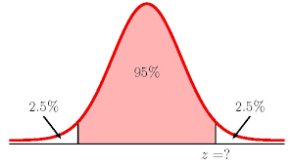
Determining Z-Score *
How did I get to 1.96?
Calculate:
AL = (1 + CI)/2 = (1 + .95)/2 = 1.95/2 = 0.975

Slide 37
You have been asked to determine the average amount that fishermen spend per year on food and lodging while on fishing trips in a certain state. Your estimate is to be within + / - $25 of the population mean; the confidence level is to be 95%; and the estimated standard deviation for the amount spent is $125 based on prior research. Thus,
H = $25
z = 1.96
σ = $125
HOW LARGE A SAMPLE DO YOU NEED?

Slide 38
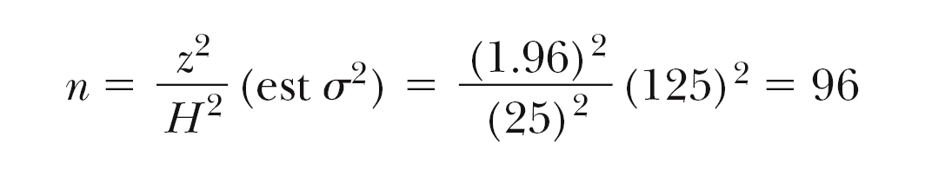
Calculation *

Slide 39
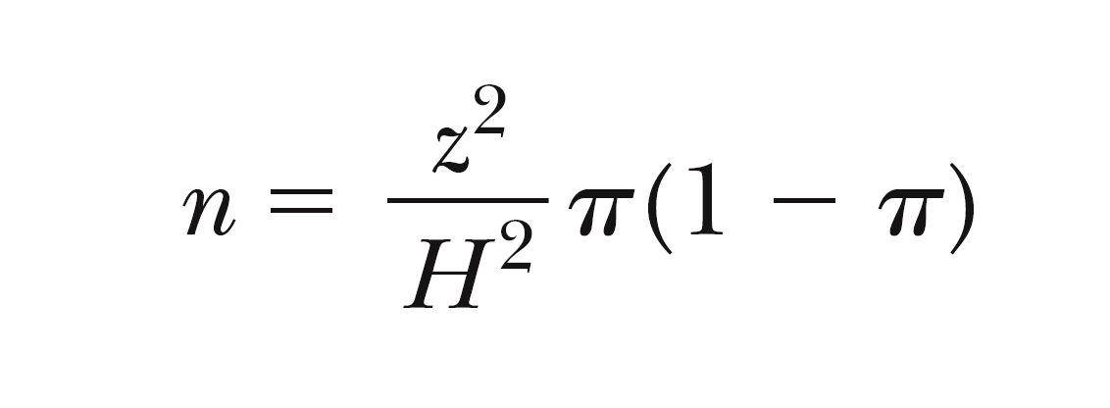
Determining Sample Size When Estimating Proportions
Where n = required sample size, z = z-score corresponding to the desired degree of confidence, H = half-precision (or how far off the estimate can be in either direction), and π = estimated population proportion.

Slide 40
When do we use the proportion formula for sample size calculation?
NOMINAL SCALES
ORDINAL SCALES

Slide 41
You have been asked to determine the proportion of all out-of-state fishermen who took at least one overnight fishing trip in the past year. Your estimate is to be within + / - 2% of the population mean; the confidence level is to be 95%; and the best guess is that 25% of out-of-state respondents have taken at least one overnight fishing trip. Thus,
H = 2%
z = 1.96
π = 25%
HOW LARGE A SAMPLE DO YOU NEED?

Slide 43
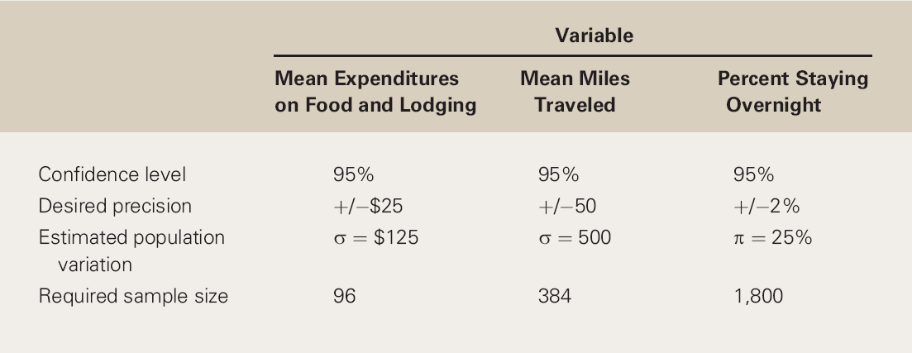
Multiple Sample Size Estimates in a Single Project
Which sample size do you select?

Slide 44
Population Size and Sample Size
Unless the sample will be more than 5-10% of the population size, the size of the population does not enter into the calculation of the size of the sample.
Many people, including managers, have trouble with this idea.

Slide 45
Other Approaches to Determining Sample Size
Size of research budget
Anticipated analyses
Historical practice

Slide 46
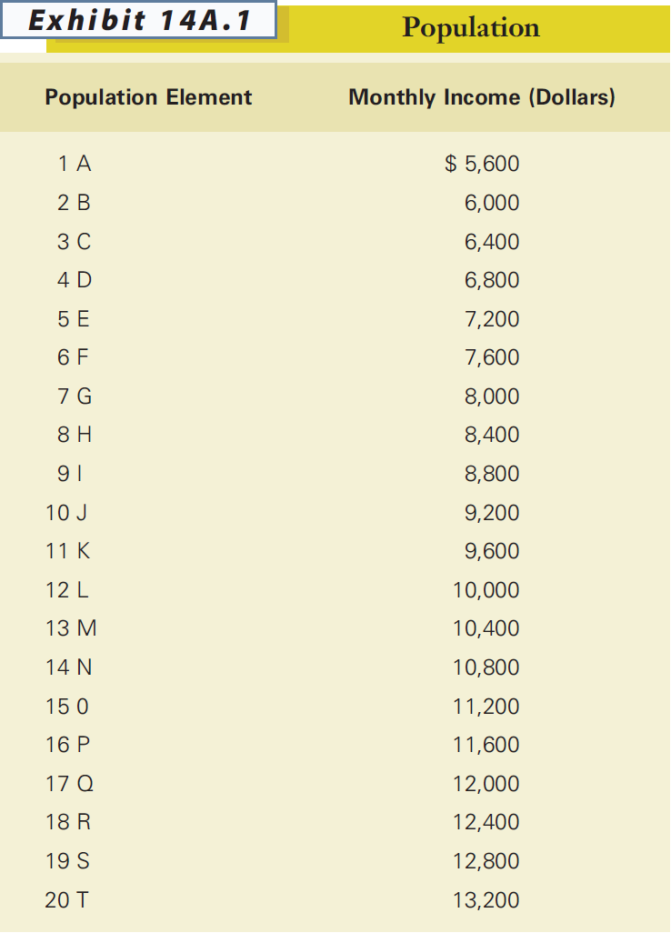
Basics of the Sampling Distribution
Population Mean (μ) = $9400

Slide 47
DERIVED POPULATION
All possible samples that can be drawn from the population under a given sampling plan.

Slide 48
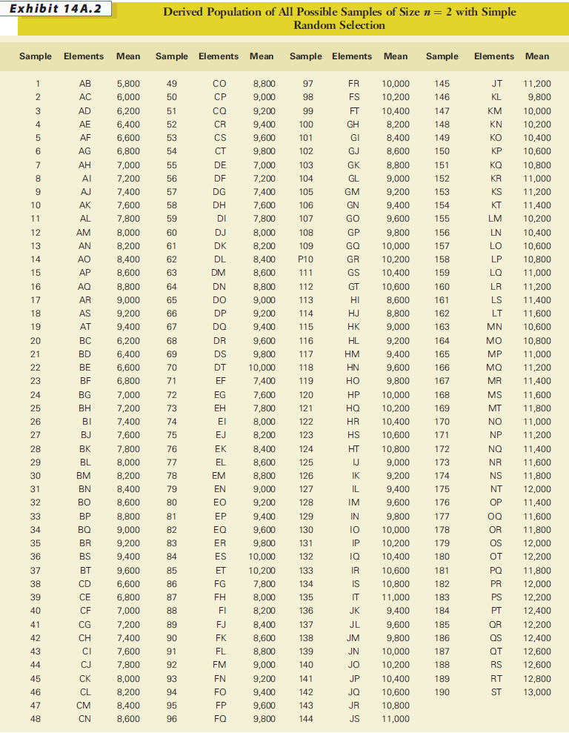

Slide 49
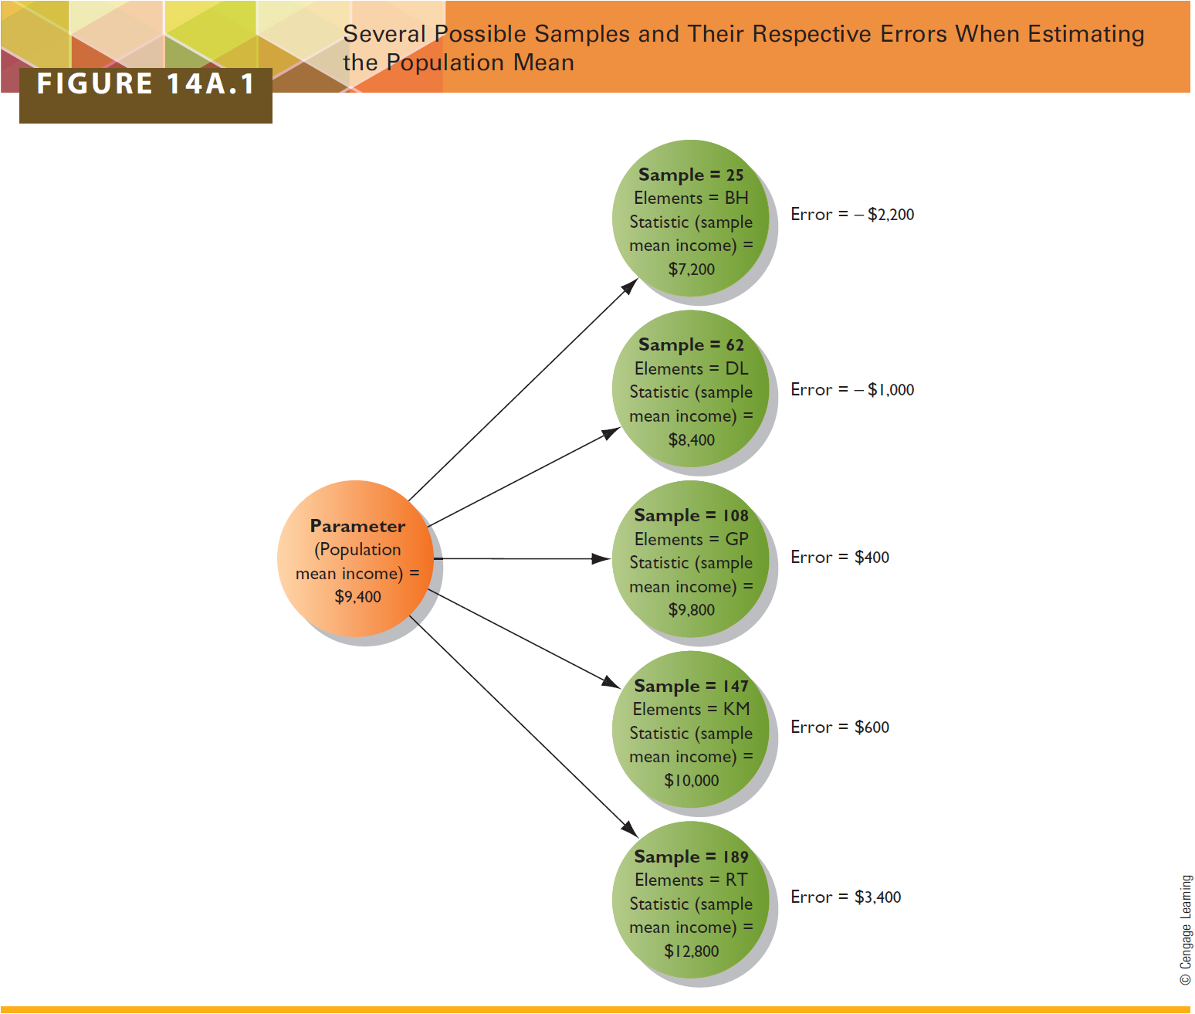

Slide 50
The mean of all possible sample means is equal to the population mean.
The variance of sample means is related to the population variance.
The sampling distribution is mound shaped.
consistent with the Central-Limit Theorem, regardless of the shape of the distribution of the variable in the population, with a sample size of 30 (and sometimes a lot less), the distribution of sample means becomes normally distributed

Slide 51


